Slide 1
iPad
7:11 PM
Navigation bar
Home
A long way home
Button
Disabled
Item 1
Item 2
Item 3


Delete
Move
Cancel
Downloading 34 of 67
Cancel
Toolbar
Back
A long way back
Button
Disabled
Item 1
Item 2
Item 3


Translucent Toolbar
New




Done
All Contacts
Back
+

Slide 2
ON
i
+
1234
OFF
Button
Button
Button
Button
Button
Button
Button
Button
Wed
Thu
Sat
Sun
Nov 9
Nov 10
Today
Nov 12
Nov 13
4
5
6
7
8
50
55
00
05
10
AM
PM
4
5
6
7
8
50
55
00
05
10
AM
PM
0
1
2 hours
3
4
4
5
6 minutes
7
8
Notes
URL
RadioButton
Checkbox
RadioButton
Checkbox

Slide 3
New item
Cancel
Save
Title
Untitled
Category
Undefined
Q
W
E
R
T
Y
U
I
O
P
A
S
D
F
G
H
J
K
L
return
Z
X
C
V
B
N
M
@
.
.?123
_
-

Slide 4
iPad
7:11 PM
Options
Settings
Option
Option
Option
Option
Option
Option
Option
Option
Option
Option
Option
Option
15 minutes
Option
Option
Every Week
Option
Always
Option
ON
Option
OFF
Option
Updated 20 minutes ago

Slide 5
United States
Drop Down
All Items
Done
Cancel
Home
Edit
United Arab Emirates
United Kingdom
United States
US Minor Outlying Isl.
Uruguay
Option
ON
Section Title
47%
Option
Option
choice
Option
OFF
Reply
Forward
Wed
Thu
Sat
Sun
Nov 9
Nov 10
Today
Nov 12
Nov 13
4
5
6
7
8
50
55
00
05
10
AM
PM
Print
Delete
Updated 20 minutes ago

Slide 6
Items List
Message Dialog
Text Size
New
Done
You need to hold your device upside down, shake it sideways then touch your nose to activate this feature
T
T
Item
Delete
Item
Item
Item 1
Item 2
Item 3
Item
Cancel
OK
Item
Item
Item
Item Properties
Item 1
Item 3
Item
Item 1
Item 2
Item 3
Item 1

Slide 7



All Items
A
A
B
C
D
E
F
G
H
I
J
K
L
M
N
O
P
Q
R
S
T
U
V
W
X
Y
Z
#
A item
B
B item
B item
Enter Password
C
Enter your password
C item
Dialog Box Title
C item
Dialog text message goes here, and second line goes here
C item
C item
Cancel
OK
1 | 2 | 3
4 | 5 | 6
7 | 8 | 9
 | 0
D
D item
Dialog Box Title
D item
Text field title
D item
D item
Cancel
OK
E
Upload
Favorites
Settings
More

Slide 8
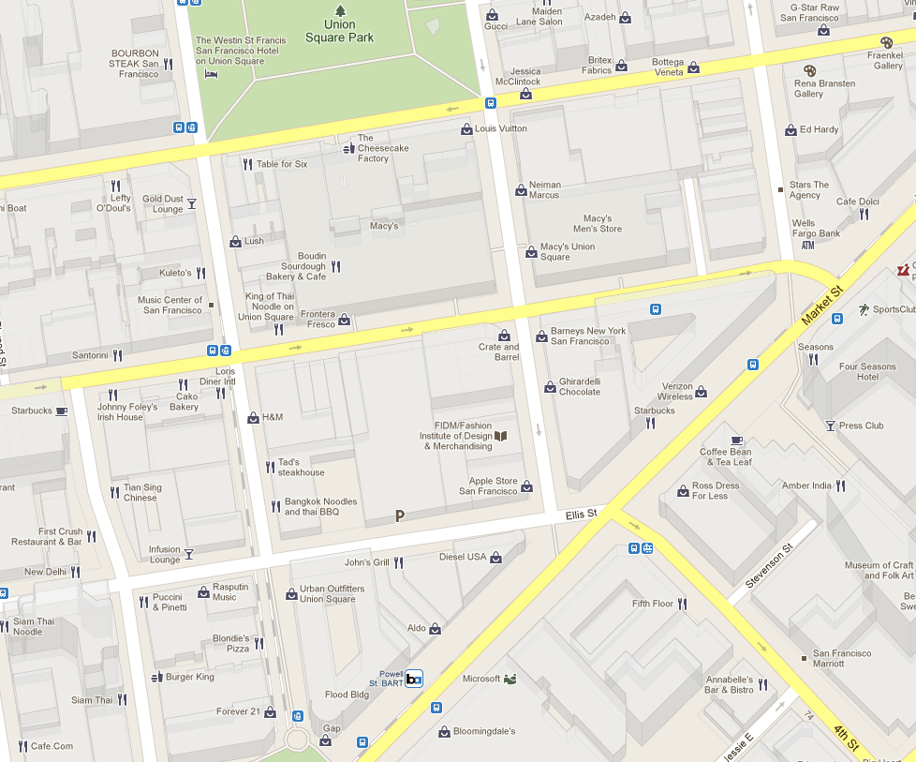

iPad
7:11 PM
Friend Finder
Item 1
Item 2
Item 3
Menu
Friend Name
i
Location Properties
Directions To Here
Directions From Here
Address
700 Elis St
San Francisco California
94103
United States
Add to
Contacts
Share
Location
Add to
Favorites

Slide 9
iPad
7:11 PM
Button

Slide 10


Notification Title
7:26 am
Notification snippet line 1
Notification snippet line 2
iPad
7:11 PM
Facebook
Amir Khella
Amir Khella commented on his post: "how to create an interactive iPhone prototype"
Amir Khella commented on his post: "how to create an interactive iPhone prototype"

